Slide 1
Describing Archives: A Content Standard
Presenter:
Jackie Dean
July 31, 2016
Atlanta, GA
©2016 Society of American Archivists

Slide 2
Arrangement & Description
SAA Curriculum and Certificate Program:
Foundational Courses—must pass 3
Arrangement and Description: Fundamentals AND
Describing Archives: A Content Standard (DACS) are required.
Tactical and Strategic Courses—must pass 3
Copyright Issues in Digital Archives OR
Privacy and Confidentiality Issues in Digital Archives is required.
Tools and Services Courses—must pass 1
Transformational Courses—must pass 1
Course examinations are administered online
2

Slide 3
Jackie Dean
University of North Carolina at Chapel Hill Head of the Archival Processing Section Chapel Hill, NC
Jackie Dean is the Head of the Archival Processing Section in the Special Collections Technical Services Department at The Louis Round Wilson Special Collections Library at the University of North Carolina at Chapel Hill. She received a B. A. in English and M.S.LS from UNC-Chapel Hill. Jackie has worked at Harvard University's Houghton Library, at the Special Collections Research Center at North Carolina State University, and for North Carolina Exploring Cultural Heritage Online (NC ECHO).

Slide 4
Today’s Objectives
To apply the concepts we learned about in the DACS workshop video series
To work together to learn to create effective, insightful description
4

Slide 5
Schedule
Time | Activity
9:00am-10:00am | Discussion, Review, Standards Bingo
10:00am-10:15am | Break
10:15am-11:30am | Titles, Discussion
11:30am-1pm | Lunch
1pm-3pm | Accessioning-to-Access Workflow, Tricky Records
3pm-3:15pm | Break
3:15pm-5pm | Authority Records, Crit Room
5

Slide 6
Discussion
What is archival description?
6

Slide 7
Archival description is not only a product but is the encompassing process by which we create representations and explanations of records.

Slide 8
Archival Description
“the process of analyzing, organizing, and recording details about the formal elements of a record or collection of records, such as creator, title, dates, extent, and contents, to facilitate the work’s identifications, management, and understanding”
– Society of American Archivists’ A Glossary of Archival and Records Terminology

Slide 9
Archival description is unique and complex
Records have value in content but also as evidence of creators and contexts that produced them
Description focuses on intellectually-significant groups of material
Level of detail will depend on records as well as needs of the institution and users

Slide 10
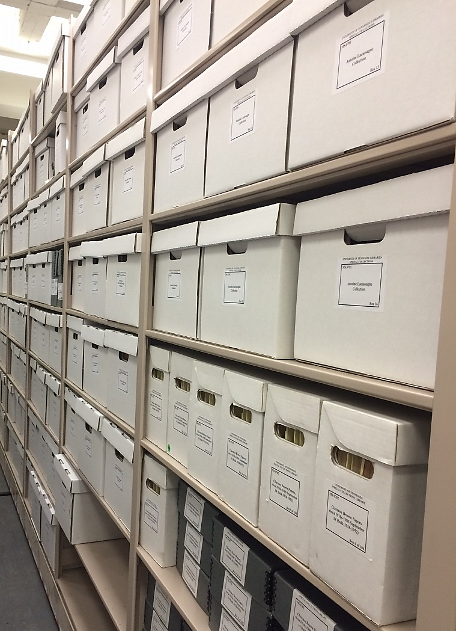
Archival description is mostly constituted by information about material’s stated content and physical attributes.

Slide 11
Archival description includes contextual information
Essential to the understanding of archival records’ authenticity and reliability
Examples of contextual information:
Biographical narratives or organizational histories
Further detail on historical context in which records were created
Details about how records were maintained over time
Includes archivists’ interventions

Slide 12
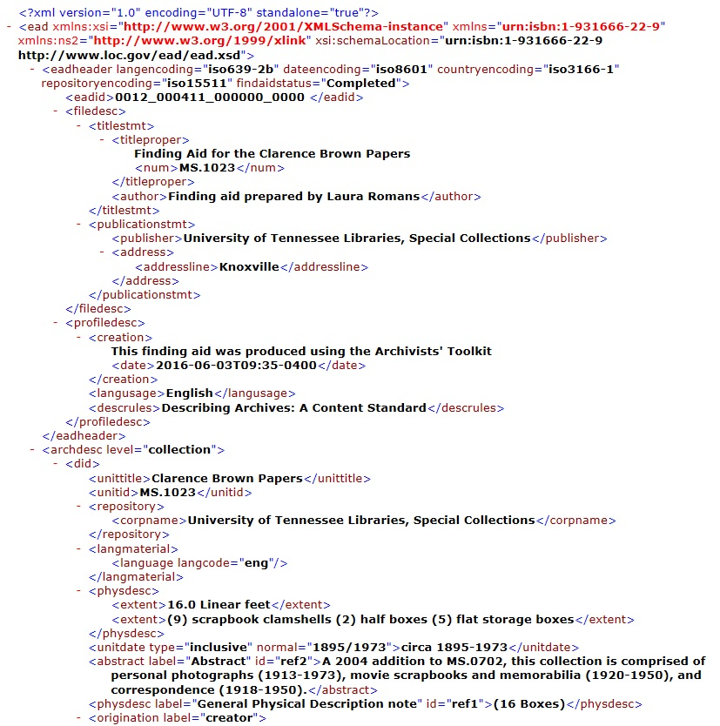
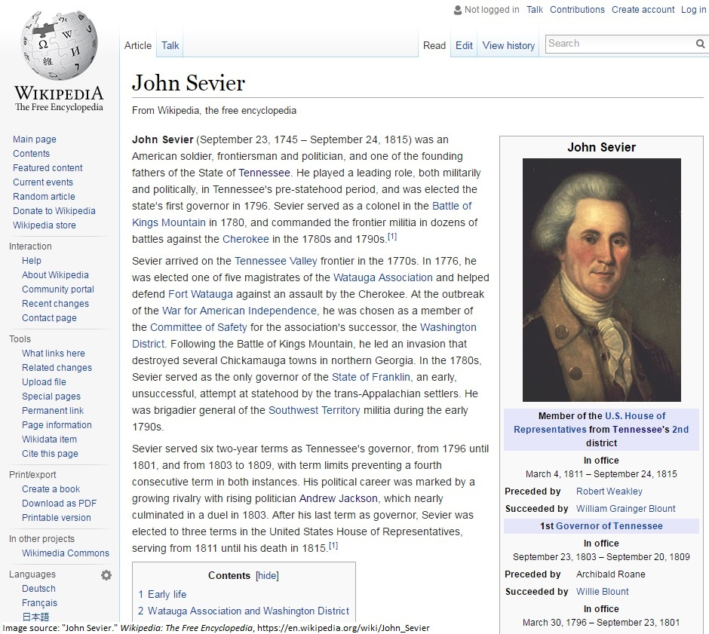
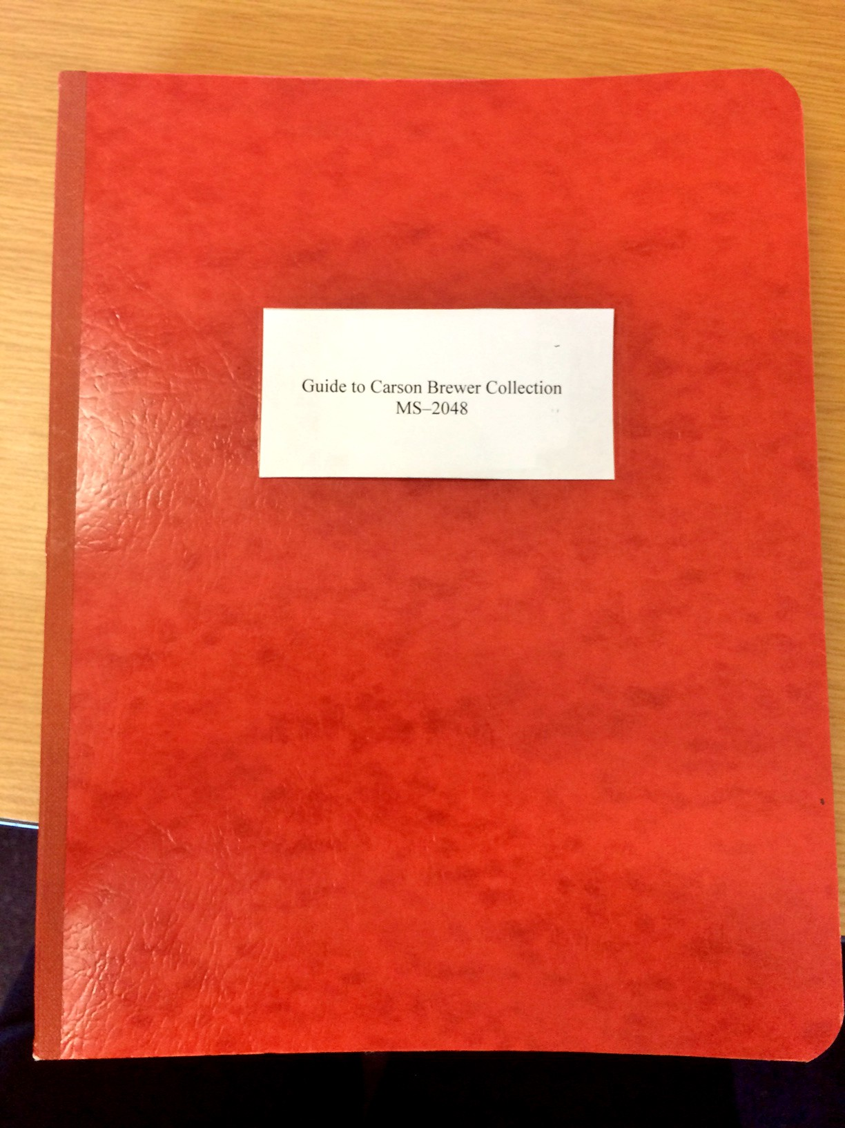
Final Product
Discovery tools will look different at each institution
Will depend on needs of users and institution as well as nature of records

Slide 13
Archival Description is Iterative
Description can and should be re-used and revised
Outputs are endlessly flexible and responsive

Slide 14
Purposes of Archival Description
Facilitates access
Improves collection management
Description is the bridge between acquisition and use!

Slide 15
Archival Description
Process of explaining content, structure, and context of archival records
Facilitates access to archival records so users may engage with them in meaningful ways

Slide 16
Discussion
What is a content standard and what is the relationship between content and encoding?
16

Slide 17
What is a content standard?
A data content standard is a set of formal rules that specify information content to promote consistency and clarity.
Data content standards provide guidelines on what kind of data to include. For example, DACS requires the inclusion of a title and also provides guidance for how that title should be derived and expressed.

Slide 18
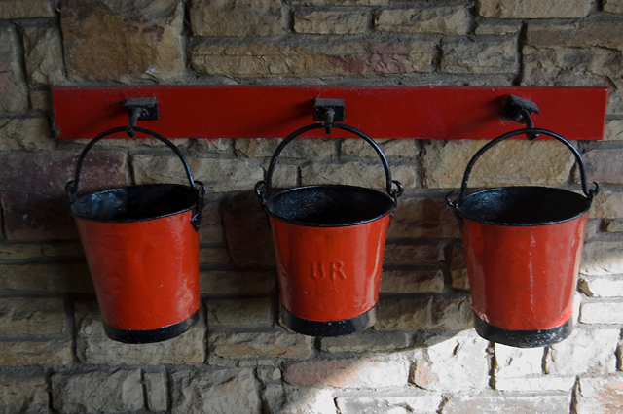
Content Standard vs. Encoding Standard
Encoding standards tell you what the buckets are
Content standards tell you what to put into the buckets
Paul Harrop, http://www.geograph.org.uk/photo/2666296

Slide 19
Encoding standard = Data Structure Standard

Slide 20
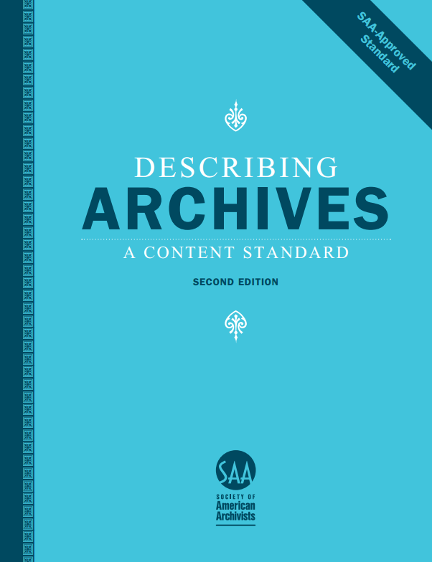
Content standard = DACS, RDA, CCO

Slide 21
1994
ISAD(G)
Babycoverart.jpg

Slide 22
I
ISAD (G) 26 Elements
Identity Statement
Context
Content and Structure
Condition of Access and Use
Allied Materials
Note
Description Control

Slide 23
Exercise 1
Standards Bingo
23
Notes:
*

Slide 24
Exercise 1 Learning Objective
To understand how to map or crosswalk DACS elements to elements in a variety of other standards
24

Slide 25
15-minute break
Notes:
25

Slide 26
Discussion
Introduction to Part 1 DACS elements
26

Slide 30
Exercise 2
Writing Good Titles
30

Slide 31
Exercise 2 Learning Objectives
Learn how to create devised titles for all levels of description from sources available
Understand that good titles are generally comprised of two parts (name of creator/collector + nature of the materials)
Determine name(s)
Identify which term(s) to use for nature of materials
Identify that good titles occasionally should include a topical statement on the scope of the unit being described (i.e. a third part)
Understand the relationship between title and creator (when creator is known)
31
Notes:
*

Slide 32
Discussion
How does DACS fit into the work of your repository?
32
Notes:
Review results from web-based quizzes on DACS principles and elements. Instructor will spend time on the areas where students seem weakest.
*

Slide 33
Why is it useful to use a content standard?
Content standards like DACS provide institutions with a way to consistently achieve intellectual control.
Content standards are often used in association with other types of standards, such as structure or value standards.
The use of companion standards allows for interoperability.
Use of DACS promotes consistency and clarity across access points, such as titles or names of creators.

Slide 34
What kinds of issues does using a content standard resolve?
Iteration: DACS can and should be used throughout the archival enterprise as the archivist learns more about the collection.

Slide 35
What kinds of issues does using a content standard resolve?
Output neutrality
Library catalog record
Finding aid
Wikipedia article
Digital object metadata record

Slide 36
Lunchtime!
See you back here at 1pm
Notes:
*

Slide 37
Exercise 3
Accessioning-to-Access Workflow
37

Slide 38
Exercise 3 Learning Objectives
To understand how DACS can act as a guidepost in creating robust accession records that facilitate access to materials and support future arrangement and description efforts
To learn how to evaluate typical sources of documentation that accompany archival materials upon their arrival in the archives
To create descriptive information about archival materials based on DACS guidance
To understand DACS as an output-neutral and system-agnostic standard
38

Slide 39
Exercise 4
Writing DACS-compliant description for tricky records
39
Notes:
How does the content standard define it? What guidance the the standard give for good description? What are the roles of principles vs. rules? What does it mean for a content standard to be output-neutral? Discuss differences between transcription, description, documentation and sensemaking.
*

Slide 40
Exercise 4 Learning Objectives
To understand that DACS applies to all archival materials, regardless of form or medium
To understand that good description requires professional judgment and thoughtful application of DACS
40

Slide 41
15-minute break
Notes:
*

Slide 42
Discussion
Authority Records
42
Notes:
*

Slide 43
Archival authority records
Principle 8 in the DACS Statement of Principles: The creators of archival materials, as well as the materials themselves, must be described.
How?
Finding Aid
Materials
Creators
Archival Authority Record
Creators

Slide 44
What IS an archival authority record? According to DACS…
The archival authority record is a description of a personal, family, or corporate entity associated with a body of archival materials, typically where that name is used as an access point to a description of those records.
It gives us additional information and context to fully understand the creation and use of archival materials being described.

Slide 45
Details, details…
The archival authority record:
Identifies and describes a person, corporate body, or family (“entity”) associated with the archival materials
Documents relationships between these entities and the archival materials
May control the form of the name locally
Relies on consistency and uniqueness

Slide 46
Source: https://www.accesstomemory.org/es/docs/2.2/_images/authority-record-example.png

Slide 47
What is required in an archival authority record?
4 types of information:
Identity (Name)
Description
Relationships
Control

Slide 48
Identity (Name)
Authoritative, standardized form of the name and any variant names
Create an authority record for each person, family, corporate body associated with the creation of archival materials
Ex.
Child, Julia
Or
Child, Lydia Maria, 1802-1880
Or
<corpname>New England Confectionary Company</corpname>
You can also indicate what kind of entity this is through codes or text. See above for an EAD encoding example of a corporate entity.

Slide 49
Description
The history and activities of the entity being described in the archival material (and is the subject of the authority record)
Administrative or biographical history
Ex.
Freddie Mercury, born Farrokh Bulsara on September 5, 1946, was a British singer, songwriter and record producer, known as the lead vocalist and co-principal songwriter of the rock band Queen. [Biography continues…]

Slide 50
Relationships resources
Relationships of the entity to other entities and information
Includes earlier names or other forms of names.
Ex.
Mercury, Freddie
Related name: Queen (Musical Group)

Slide 51
Control
Documentation of how authority record was created and maintained
Ex.
Authority record identifier (local):
01-0010205
Or
Rules/Conventions:
DACS
Or
Dates:
Created 15 June 2016. Revised 21 June 2016.
Or
A title/identifier of related resources:
A biography of Alexander Hamilton is available at http://www.pbs.org/wgbh/amex/duel/peopleevents/pande06.html

Slide 52
Why is the authority record useful?
Captures useful information about creators
Maintains in a separate system of authority records
Linked records

Slide 53
Archival authority record vs. Library (bibliographic) authority record
Contextual information
Detailed relationships model
Bounding of entities

Slide 54
Advantages of creating archival authority records
Reduce duplication and error
Document relationships
Access
Reduce maintenance
Record-creation context
Complex entity identification (i.e. name changes)
Data exchange

Slide 55
Where are archival authority records found?
Electronically: OPAC, finding aids
Paper-based
Shelf lists
Print finding aids or guides
Card catalogs

Slide 56
Exercise 5
Evaluating Archival Authority Records
56
Notes:
*

Slide 57
Exercise 5 Learning Objectives
To understand the reasons for creating a DACS-compliant authority record
To understand the minimum element set that constitutes a DACS-compliant authority record
To evaluate the parts of an authority record against DACS guidance
To understand that DACS-compliant authority records are output-neutral
57

Slide 58
Crit Room
Notes:
Talk again about management tools, publication, and the archival management lifecycle.
*

